Slide 1
MAIN MEMORY

Slide 2
Introduction
Swapping
Contiguous Memory Allocation
Paging
Structure of the Page Table

Slide 3
1.Introduction
Memory consists of a large array of bytes, each with its own address.
The CPU fetches instructions from memory according to the value of the program counter
A typical instruction-execution cycle, for example,
  first fetches an instruction from memory.
  The instruction is then decoded and may cause operands to be fetched from memory.
  After the instruction has been executed on the operands, results may be stored back in memory

Slide 4
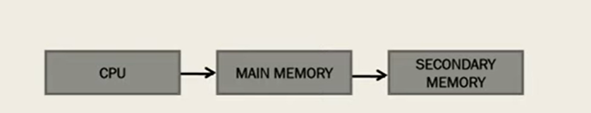
TASK OF OPERATING SYSTEM
1. Which data from the secondary memory should come to main memory and at which location.
2. CPU generates address for data at secondary memory. but have access to main memory. thus operating system performs the address translation.

Slide 5
Following are the functions of Memory Management module of operating system:
Keep track of the status of each memory location whether the memory is allocated or free.
Determining allocation policy for the memory.
Memory allocation techniques, memory allocation information updating.
Providing memory protection schemes which are critical to accomplish.

Slide 6
1.1 Basic Hardware
Main memory and the registers built into each processing core are the only general-purpose storage that the CPU can access directly.
Any instructions in execution, and any data being used by the instructions, must be in one of these direct-access storage devices.
  If the data are not in memory, they must be moved there before the CPU can operate on them.
For proper system operation, we must protect the operating system from access by user processes, as well as protect user processes from one another.
  This protection must be provided by the hardware, because the operating system doesn’t usually intervene between the CPU and its memory accesses

Slide 7
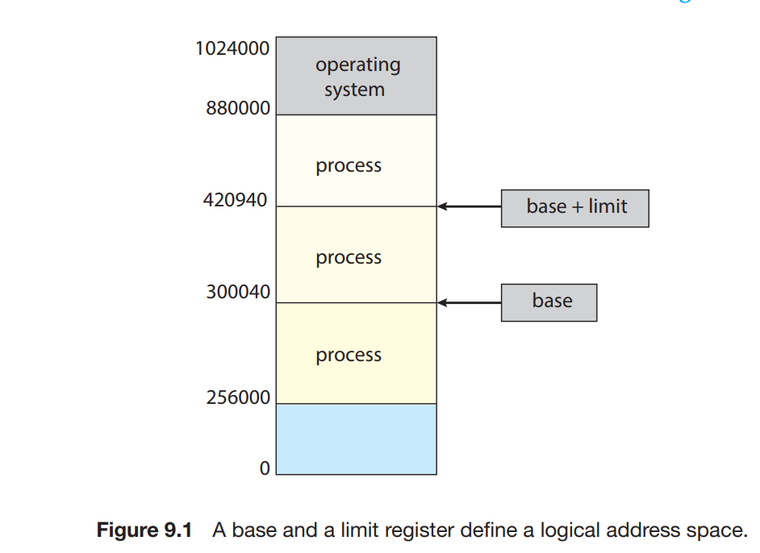
This protection is provided by using two registers, usually
  A base register and
  a limit register.
The base register holds the smallest legal physical memory address; the limit register specifies the size of the range.
For example, if the base register holds 300040 and the limit register is 120900, then the program can legally access all addresses from 300040 through 420939 (inclusive)

Slide 8
Protection of memory space is accomplished by having the CPU hardware compare every address generated in user mode with the registers.
  The base and limit registers can be loaded only by the operating system, which uses a special privileged instruction.
  Since privileged instructions can be executed only in kernel mode, and since only the operating system executes in kernel mode, only the operating system can load the base and limit registers.
Any attempt by a program executing in user mode to access operating-system memory or other users’ memory results in a trap to the operating system, which treats the attempt as a fatal error .
This scheme prevents a user program from (accidentally or deliberately) modifying the code or data structures of either the operating system or other users.

Slide 9
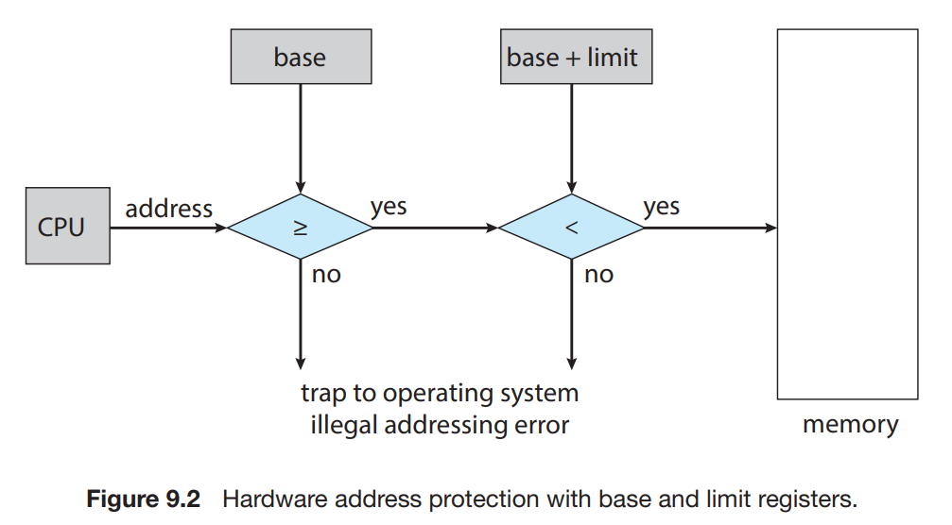

Slide 10
1.2 Address Binding
Programs must be brought into memory and placed within a process queue for it to be run.
Input queue or job queue - collection of processes on the disk that are waiting to be brought into memory to run the program.
User programs go through several steps before being executed.
Binding an address to the data or instruction of a process is called address binding.
It can be done at three points of time:
          Compile time
          Load Time
          Run time

Slide 11
Compile time.
  If you know at compile time where the process will reside in memory, then absolute code can be generated.
  For example, if you know that a user process will reside starting at location R, then the generated compiler code will start at that location and extend up from there. If, at some later time, the starting location changes, then it will be necessary to recompile this code
Load time.
  If it is not known at compile time where the process will reside in memory, then the compiler must generate relocatable code.
  In this case, final binding is delayed until load time. If the starting address changes, we need only reload the user code to incorporate this changed value

Slide 12
Execution time.
  If the process can be moved during its execution from one memory segment to another, then binding must be delayed until run time. Special hardware must be available for this scheme to work

Slide 13
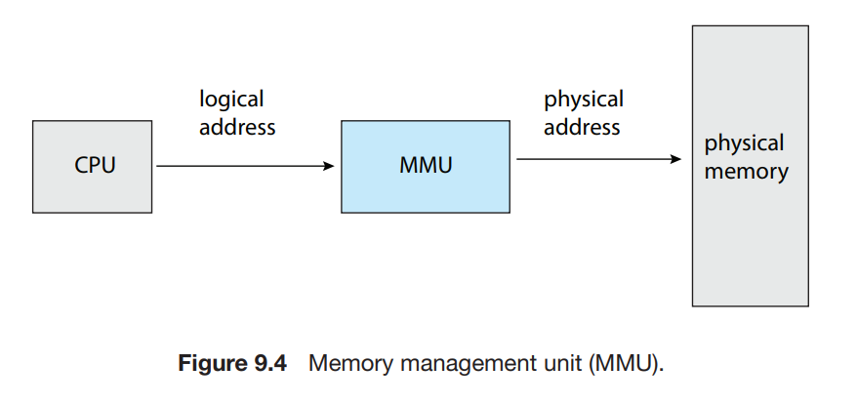
1.3 Logical versus Physical Address
Logical Address: An address generated by CPU is known as the Logical Address
Physical Address: The address seen by the memory unit that is the one loaded into the memory address register (MAR) of the memory is known as the physical address.

Slide 14
Binding addresses at either compile or load time generates identical logical and physical addresses. However, the execution-time address-binding scheme results in differing logical and physical addresses
The run-time mapping from virtual to physical addresses is done by a hardware device called the memory-management unit (MMU).
The base register is now called a relocation register.
The value in the relocation register is added to every address generated by a user process at the time the address is sent to memory.
For example, if the base is at 14000, then an attempt by the user to address location 0 is dynamically relocated to location 14000; an access to location 346 is mapped to location 14346

Slide 15
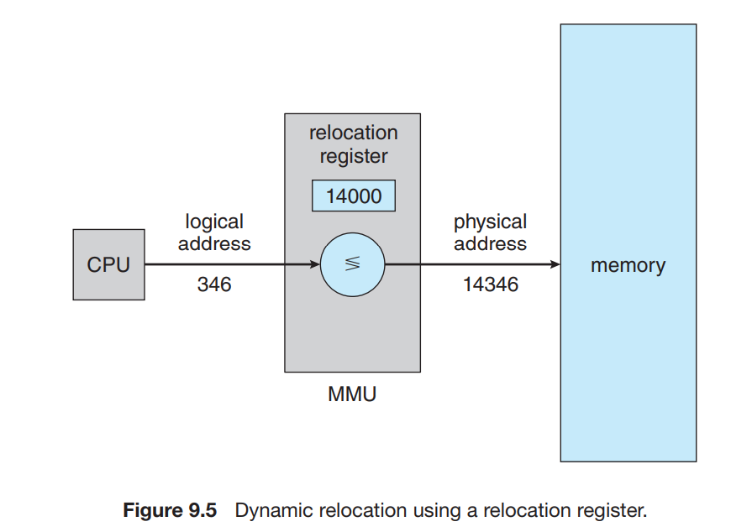

Slide 16
We now have two different types of addresses:
  logical addresses (in the range 0 to max) and
  physical addresses (in the range R + 0 to R + max for a base value R).
The user program generates only logical addresses and thinks that the process runs in memory locations from 0 to max. However, these logical addresses must be mapped to physical addresses before they are used.

Slide 17
1.4 Dynamic Loading
To obtain better memory-space utilization, we can use dynamic loading.
With dynamic loading, a routine is not loaded until it is called.
All routines are kept on disk in a relocatable load format. The main program is loaded into memory and is executed.
When a routine needs to call another routine, the calling routine first checks to see whether the other routine has been loaded.
If it has not, the relocatable linking loader is called to load the desired routine into memory and to update the program’s address tables to reflect this change. Then control is passed to the newly loaded routine

Slide 18
1.5 Dynamic Linking and Shared Libraries
Dynamically linked libraries (DLLs) are system libraries that are linked to user programs when the programs are run
Some operating systems support only static linking, in which system libraries are treated like any other object module and are combined by the loader into the binary program image.
Dynamic linking, in contrast, is similar to dynamic loading. Here, though, linking, rather than loading, is postponed until execution time.
When a program references a routine that is in a dynamic library, the loader locates the DLL, loading it into memory if necessary.
  It then adjusts addresses that reference functions in the dynamic library to the location in memory where the DLL is stored.

Slide 19
The main advantage of DLLs is that these libraries can be shared among multiple processes, so that only one instance of the DLL in main memory.
  For this reason, DLLs are also known as shared libraries, and are used extensively in Windows and Linux systems.

Slide 20
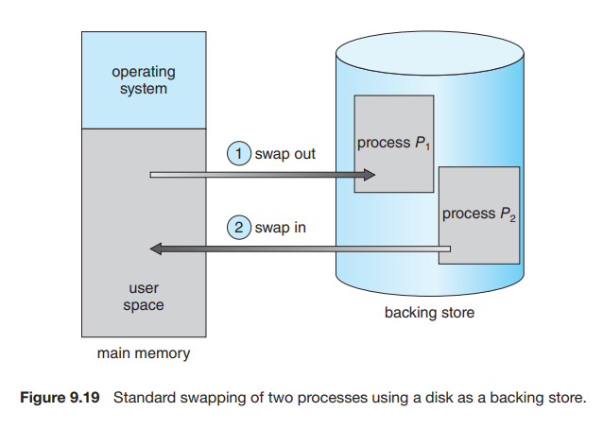
2. Swapping

Slide 21
Process instructions and the data they operate on must be in memory to be executed.
However, a process, or a portion of a process, can be swapped temporarily out of memory to a backing store and then brought back into memory for continued execution .
Swapping makes it possible for the total physical address space of all processes to exceed the real physical memory of the system, thus increasing the degree of multiprogramming in a system.
The advantage of standard swapping is that it allows physical memory to be oversubscribed, so that the system can accommodate more processes than there is actual physical memory to store them.

Slide 22
Swapping with Paging
Most systems, including Linux and Windows, now use a variation of swapping in which pages of a process—rather than an entire process—can be swapped. This strategy still allows physical memory to be oversubscribed, but does not incur the cost of swapping entire processes.
A page out operation moves a page from memory to the backing store; the reverse process is known as a page in

Slide 23
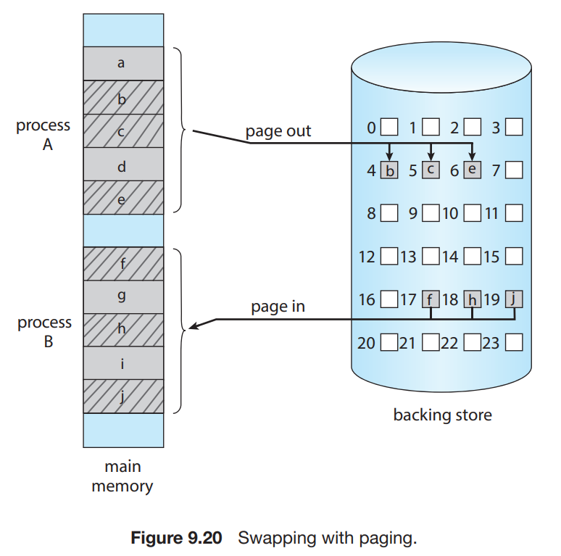

Slide 24
3.Contiguous Memory Allocation
Memory Allocation
Contiguous Memory Allocation
Fixed or Static Partition/Allocation
Dynamic or Variable Partition/Allocation
Non Contiguous Memory Allocation

Slide 25
The main memory must accommodate both the operating system and the various user processes.
The memory is usually divided into two partitions: one for the operating system and one for the user processes.
We can place the operating system in either low memory addresses or high memory addresses.
In contiguous memory allocation, each process is contained in a single section of memory that is contiguous to the section containing the next process.
  An entire program is stored at a single continuous memory location.It is known as centralized approach.

Slide 26
3.1 Memory Protection
We can prevent a process from accessing memory that it does not own by combining a relocation register together with a limit register.
The relocation register contains the value of the smallest physical address; the limit register contains the range of logical addresses (for example, relocation = 100040 and limit = 74600).
Each logical address must fall within the range specified by the limit register. The MMU maps the logical address dynamically by adding the value in the relocation register. This mapped address is sent to memory.
Because every address generated by a CPU is checked against these registers, we can protect both the operating system and the other users’ programs and data from being modified by this running process.

Slide 27
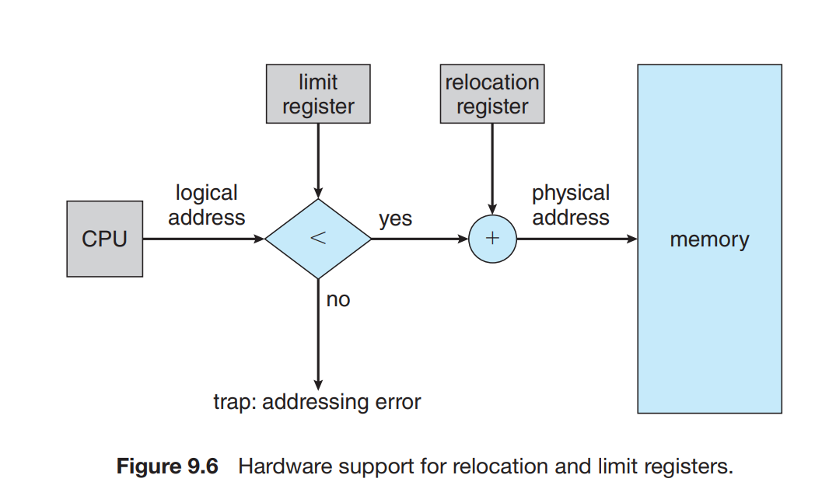

Slide 28
3.2 Memory Allocation
Memory Allocation
Contiguous Memory Allocation
Fixed or Static Partition/Allocation
Dynamic or Variable Partition/Allocation
Non Contiguous Memory Allocation

Slide 29

3.2.1 Fixed size partition or Allocation
0
1
2
3
4
5
6
7
P1
3K
Process P1 is 3K
So allocation from
Location 1 to 3
Contiguously

Slide 30
In the fixed partition scheme, memory is divided into fixed number of partitions.
Fixed means number of partitions are fixed in the memory. In the fixed partition, in every partition only one process will be accommodated.
Degree of multi-programming is restricted by number of partitions in the memory.
Maximum size of the process is restricted by maximum size of the partition

Slide 31
Disadvantage :
Where the memory allotted to the process is somewhat larger than the memory requested, then the difference between allotted and requested memory is called internal fragmentation. We fixed the sizes of the memory blocks, which has caused this issue.
0
1
2
3
4
5
6
7
P1
600 MB

Slide 32
3.2.2 Variable size partition or Allocation
The simplest methods of allocating memory is to assign processes to variably sized partitions in memory, where each partition may contain exactly one process.
In this variable partition scheme, the operating system keeps a table indicating which parts of memory are available and which are occupied.
Initially, all memory is available for user processes and is considered one large block of available memory, a hole.

Slide 33
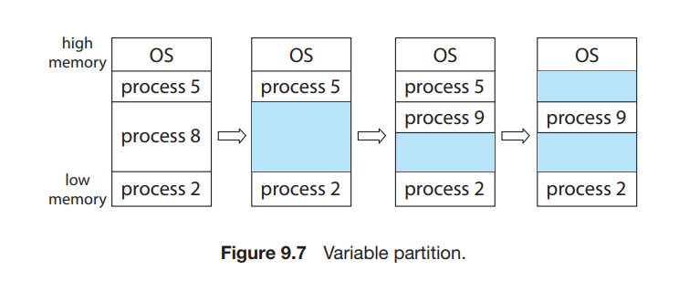
Initially, the memory is fully utilized, containing processes 5, 8, and 2. After process 8 leaves, there is one contiguous hole. Later on, process 9 arrives and is allocated memory. Then process 5 departs, resulting in two noncontiguous holes.

Slide 34
3 strategies are most commonly used to select a free hole from the set of available holes to allocate memory for processes are:
            First Fit
            Best Fit
            Worst Fit

Slide 35
First fit
Allocate the first hole that is big enough. Searching can start either at the beginning of the set of holes or at the location where the previous first-fit search ended. We can stop searching as soon as we find a free hole that is large enough.

Slide 36
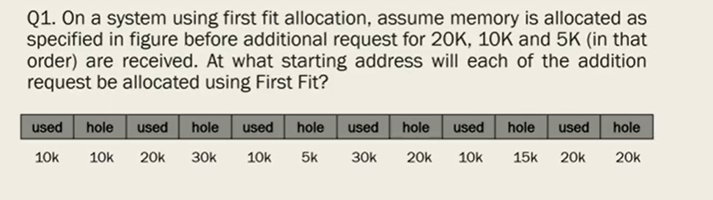

Slide 37
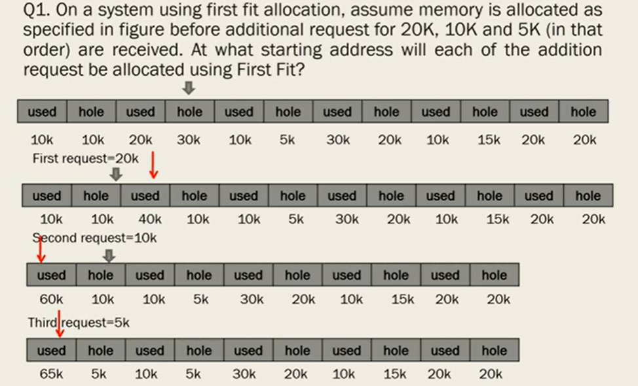

Slide 38
Worst fit
Allocate the largest hole. Again, we must search the entire list, unless it is sorted by size. This strategy produces the largest leftover hole, which may be more useful than the smaller leftover hole from a best-fit approach

Slide 39
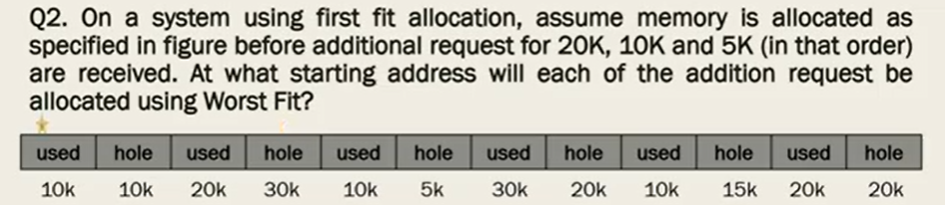

Slide 40
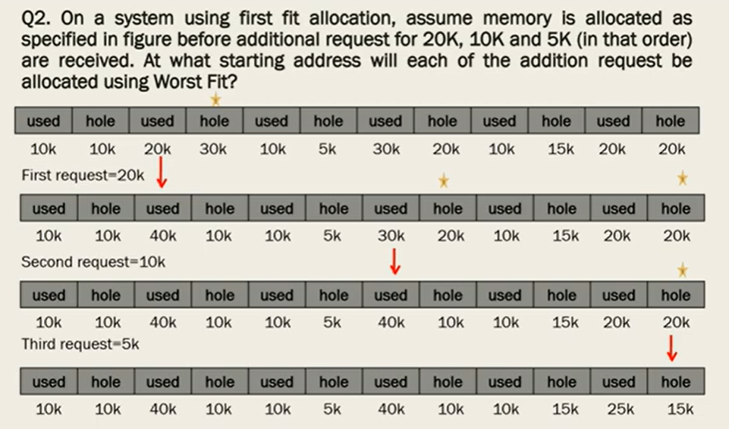

Slide 41
Best fit
Allocate the smallest hole that is big enough. We must search the entire list, unless the list is ordered by size. This strategy produces the smallest leftover hole.

Slide 42
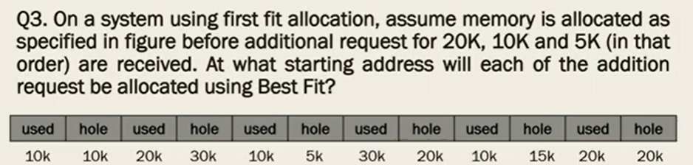

Slide 43
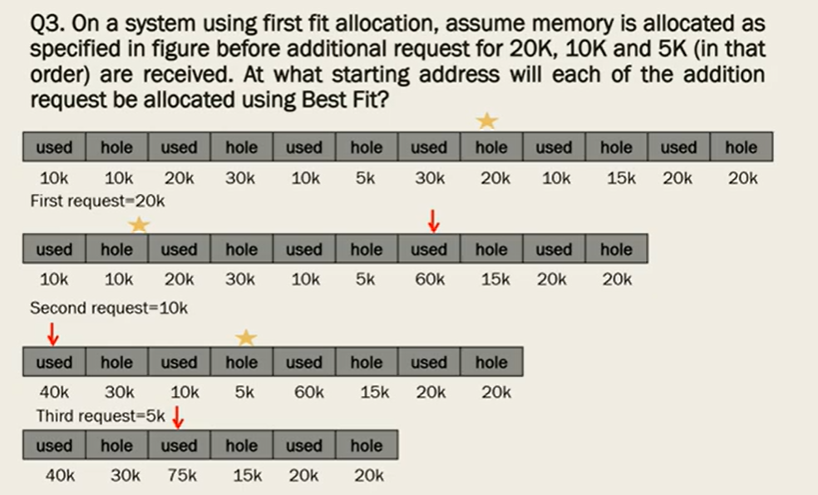

Slide 44
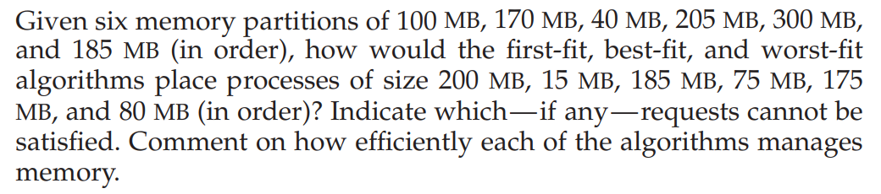
Practice :

Slide 45
3.3 Fragmentation
Both the first-fit and best-fit strategies for memory allocation suffer from external fragmentation.
As processes are loaded and removed from memory, the free memory space is broken into little pieces.
External fragmentation exists when there is enough total memory space to satisfy a request but the available spaces are not contiguous: storage is fragmented into a large number of small holes.
This fragmentation problem can be severe. In the worst case, we could have a block of free (or wasted) memory between every two processes.

Slide 46
One solution to the problem of external fragmentation is compaction. The goal is to shuffle the memory contents so as to place all free memory together in one large block.
Another possible solution to the external-fragmentation problem is to permit the logical address space of processes to be noncontiguous, thus allowing a process to be allocated physical memory wherever such memory is available.
  This is the strategy used in paging, the most common memory-management technique for computer systems

Slide 47
4. Paging
Paging is a memory management scheme that permits a process’s physical address space to be noncontiguous.
Paging avoids external fragmentation
Non Contiguous Memory Allocation
Paging
Segmentation

Slide 48
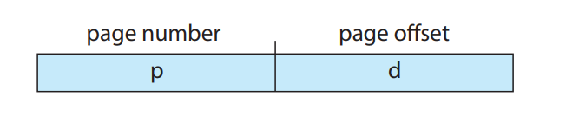
4.1 Basic Method
The basic method for implementing paging involves
  Breaking physical memory into fixed-sized blocks called frames ,
  and breaking logical memory into blocks of the same size called pages.
When a process is to be executed, its pages are loaded into any available memory frames from their source (a file system or the backing store).
The backing store is divided into fixed-sized blocks that are the same size as the memory frames or clusters of multiple frames.
Every address generated by the CPU is divided into two parts:
  a page number (p) ,and
  a page offset (d):

Slide 49
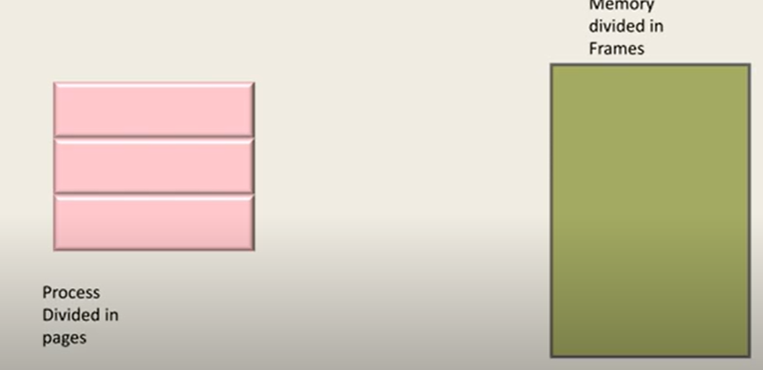
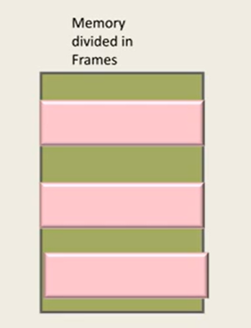

Slide 50
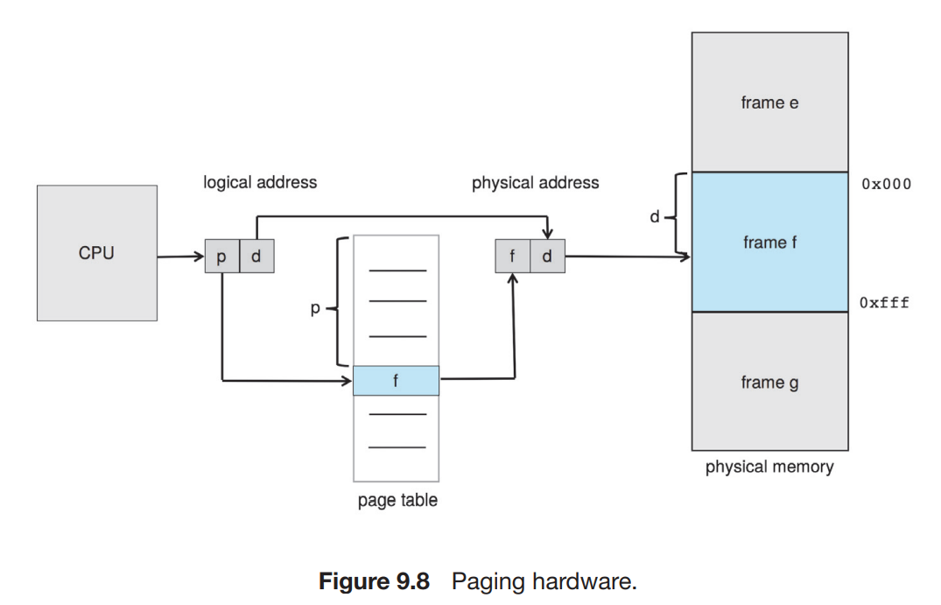
PAGING HARDWARE

Slide 51
The page number is used as an index into a per-process page table.
The page table contains the base address of each frame in physical memory, and the offset is the location in the frame being referenced.
  Thus, the base address of the frame is combined with the page offset to define the physical memory address.
The following outlines the steps taken by the MMU to translate a logical address generated by the CPU to a physical address:
  1. Extract the page number p and use it as an index into the page table
  2. Extract the corresponding frame number f from the page table.
  3. Replace the page number p in the logical address with the frame number f

Slide 52
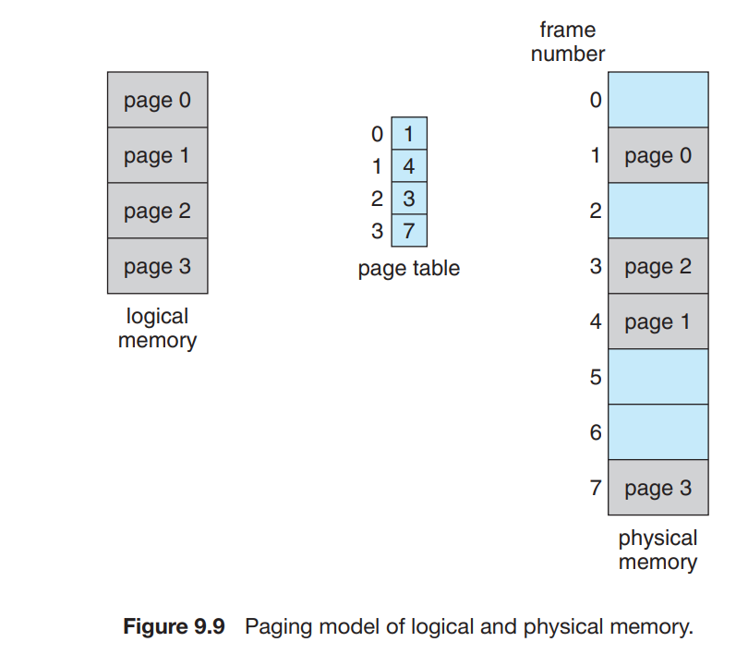

Slide 53
Using a page size of 4 bytes and a physical memory of 32 bytes (8 pages), we show how the programmer’s view of memory can be mapped into physical memory.
Logical address 0 is page 0, offset 0. Indexing into the page table, we find that page 0 is in frame 5. Thus, logical address 0 maps to physical address 20 [= (5 × 4) + 0].
Logical address 3 (page 0, offset 3) maps to physical address 23 [= (5 × 4) + 3].
Logical address 4 is page 1, offset 0; according to the page table, page 1 is mapped to frame 6. Thus, logical address 4 maps to physical address 24 [= (6 × 4) + 0]
Logical address 13 maps to physical address 9.

Slide 54
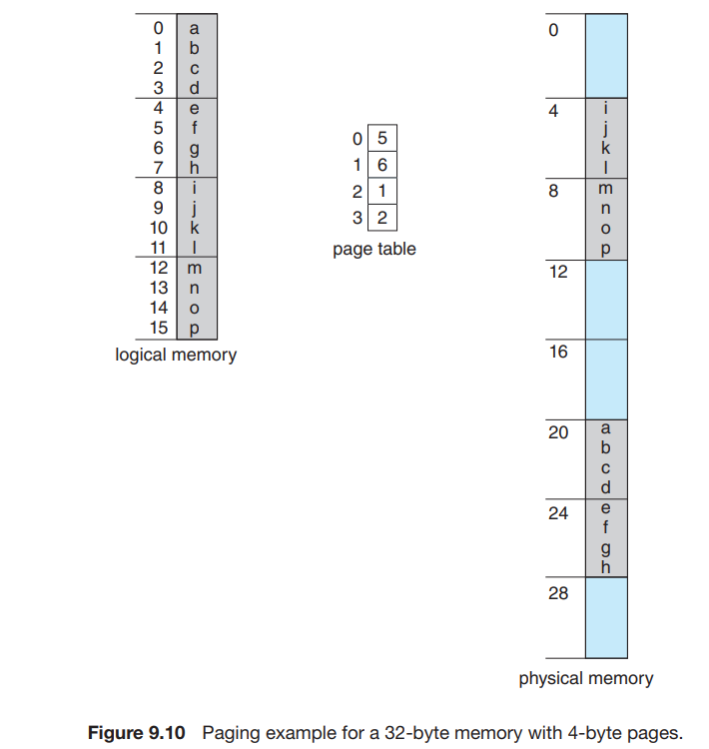

Slide 55
FRAME TABLE
Since the operating system is managing physical memory, it must be aware of the allocation details of physical memory—which frames are allocated, which frames are available, how many total frames there are, and so on.
This information is generally kept in a single, system-wide data structure called a frame table.
The frame table has one entry for each physical page frame, indicating whether the latter is free or allocated and, if it is allocated, to which page of which process

Slide 56
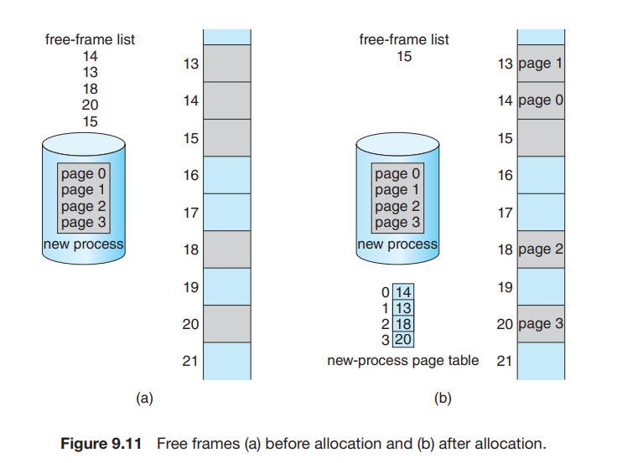

Slide 57
4.2 Hardware Support
As page tables are per-process data structures, a pointer to the page table is stored with the other register values (like the instruction pointer) in the process control block of each process.
When the CPU scheduler selects a process for execution, it must reload the user registers and the appropriate hardware page-table values from the stored user page table
Page table is kept in main memory, and a page-table base register (PTBR) points to the page table.

Slide 58
4.2.1 Translation Look-Aside Buffer
Suppose we want to access location i. We must first index into the page table, using the value in the PTBR offset by the page number for i.
This task requires one memory access. It provides us with the frame number, which is combined with the page offset to produce the actual address .
With this scheme, two memory accesses are needed to access data (one for the page-table entry and one for the actual data). Thus, memory access is slowed by a factor of 2.
The standard solution to this problem is to use a special, small, fast-lookup hardware cache called a translation look-aside buffer (TLB)

Slide 59
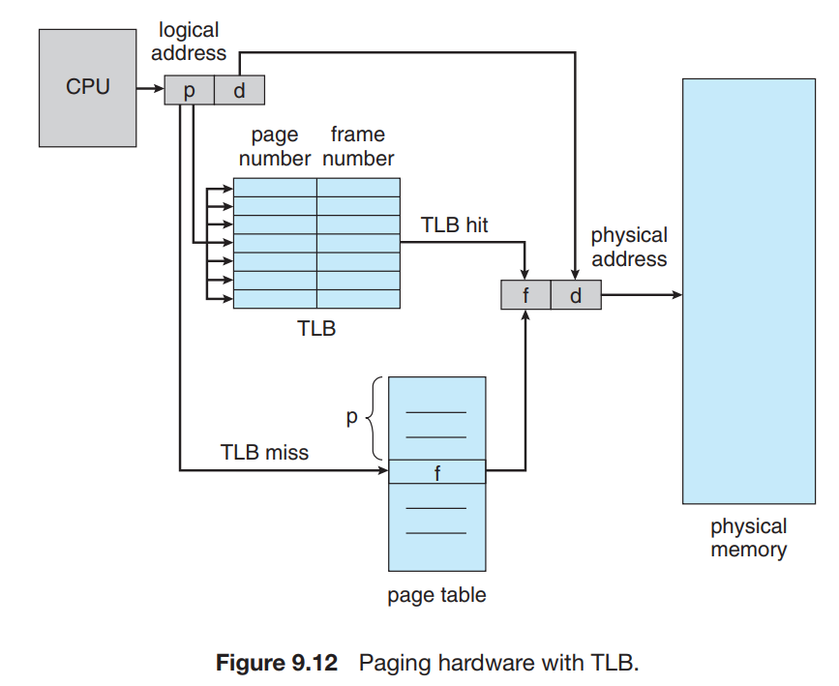
The percentage of times that the page number of interest is found in the TLB is called the hit ratio.

Slide 60
The TLB is associative, high-speed memory.
Each entry in the TLB consists of two parts: a key (or tag) and a value.
When the associative memory is presented with an item, the item is compared with all keys simultaneously.
  If the item is found, the corresponding value field is returned
The TLB contains only a few of the page-table entries. When a logical address is generated by the CPU, the MMU first checks if its page number is present in the TLB. If the page number is found (known as a TLB Hit) , its frame number is immediately available and is used to access memory.
If the page number is not in the TLB (known as a TLB miss), address translation proceeds, where a memory reference to the page table must be made. When the frame number is obtained, we can use it to access .
  In addition, we add the page number and frame number to the TLB, so that they will be found quickly on the next reference.

Slide 61
4.3 Protection : Valid/Invalid Bit
Memory protection in a paged environment is accomplished by protection bits associated with each frame. Normally, these bits are kept in the page table.
One bit can define a page to be read –write or read-only.
Every reference to memory goes through the page table to find the correct frame number.
At the same time that the physical address is being computed, the protection bits can be checked to verify that no writes are being made to a read-only page.
An attempt to write to a read-only page causes a hardware trap to the operating system

Slide 62
One additional bit is generally attached to each entry in the page table: a valid–invalid bit.
When this bit is set to valid, the associated page is in the process’s logical address space and is thus a legal (or valid) page.
When the bit is set to invalid, the page is not in the process’s logical address space. Illegal addresses are trapped by use of the valid –invalid bit.
The operating system sets this bit for each page to allow or disallow access to the page.

Slide 63
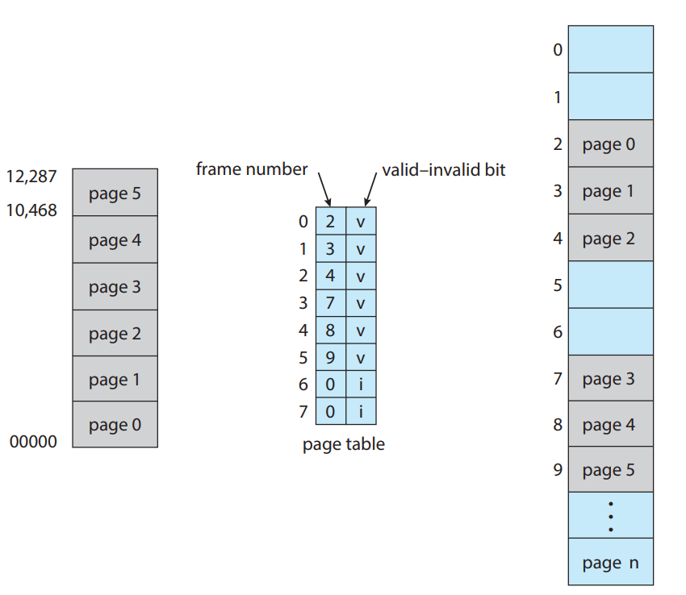

Slide 64
4.4 Shared Pages
An advantage of paging is the possibility of sharing common code, a consideration that is particularly important in an environment with multiple processes.
Consider the standard C library, most user processes require ,the standard C library libc.
One option is to have each process load its own copy of libc into its address space. If a system has 40 user processes, and the libc library is 2 MB, this would require 80 MB of memory.
The other option is Only one copy of the standard C library need to be kept in physical memory, and the page table for each user process maps onto the same physical copy of libc.
  Thus, to support 40 processes, we need only one copy of the library, and the total space now required is 2 MB instead of 80 MB—a significant saving

Slide 65
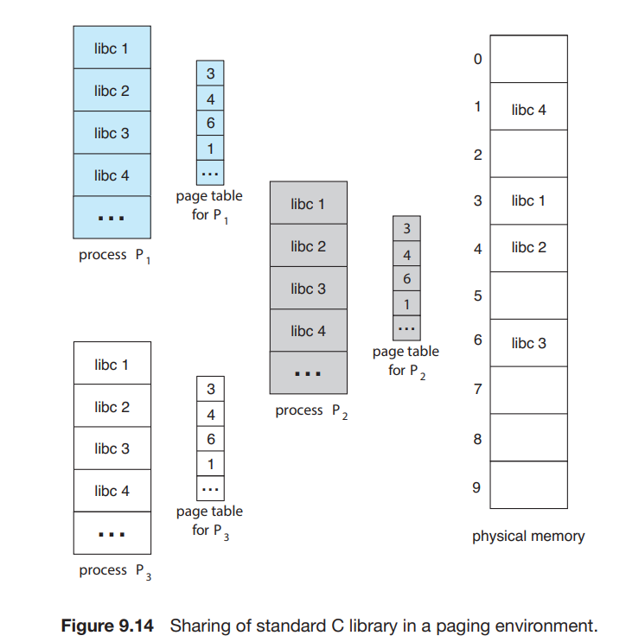

Slide 66
5. Structure of Page Table.
Most common techniques for structuring the page table including
  hierarchical paging,
  hashed page tables, and
  inverted page tables.

Slide 67
5.1 Hierarchical Paging
Most modern computer systems support a large logical address space .
In such an environment, the page table itself becomes excessively large.
For example, consider a system with a 32-bit logical address space. If the page size in such a system is 4 KB (2^12), then a page table may consist of over 1 million entries .Assuming that each entry consists of 4 bytes, each process may need up to 4 MB of physical address space for the page table alone. Clearly, we would not want to allocate the page table contiguously in main memory.
One simple solution to this problem is to divide the page table into smaller pieces

Slide 68
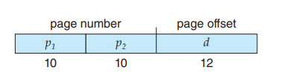
One way is to use a two-level paging algorithm, in which the page table itself is also paged .
For example, consider again the system with a 32-bit logical address space and a page size of 4 KB. A logical address is divided into a page number consisting of 20 bits and a page offset consisting of 12 bits. Because we page the page table, the page number is further divided into a 10-bit page number and a 10-bit page offset. Thus, a logical address is as follows:
where p1 is an index into the outer page table and p2 is the displacement within the page of the inner page table. The address-translation method for this architecture is shown in a forward-mapped page table.

Slide 69
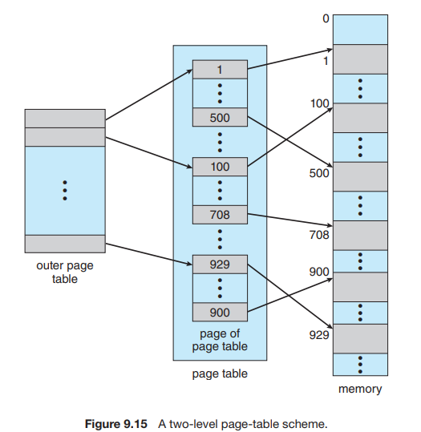

Slide 70
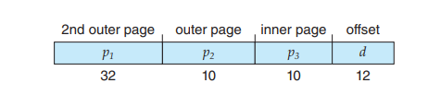
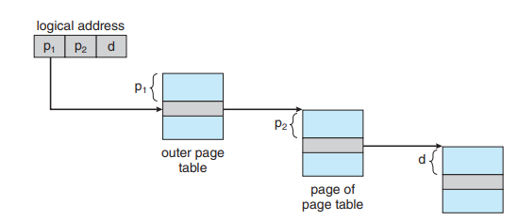
4 LEVEL PAGING

Slide 71
5.2 Hashed Page Tables
One approach for handling address spaces larger than 32 bits is to use a hashed page table, with the hash value being the virtual page number.
Each entry in the hash table contains a linked list of elements that hash to the same location (to handle collisions).
Each element consists of three fields:
  (1) the virtual page number,
  (2) the value of the mapped page frame, and
  (3) a pointer to the next element in the linked list.

Slide 72
The algorithm works as follows:
The virtual page number in the virtual address is hashed into the hash table.
The virtual page number is compared with field 1 in the first element in the linked list.
If there is a match, the corresponding page frame (field 2) is used to form the desired physical address.
  If there is no match, subsequent entries in the linked list are searched for a matching virtual page number

Slide 73
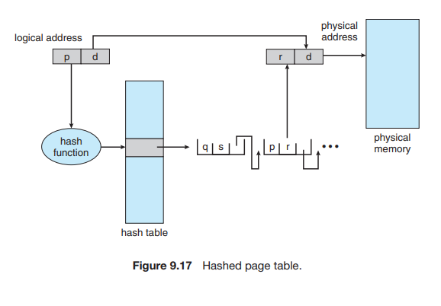

Slide 74

5.3 Inverted Page Tables
Most Operating Systems implement a separate page table for each process, i.e. for the ‘n’ number of processes running on a Multiprocessing/ Timesharing Operating System, there is an ‘n’ number of page tables stored in the memory.
Sometimes when a process is very large and it occupies virtual memory then with the size of the process, its page table size also increases substantially
In an operating system that uses virtual memory, an Inverted Page Table (IPT) is a data structure used to map physical memory pages to virtual memory pages.
It consists of a one-page table entry for every frame of the main memory. So the number of page table entries in the Inverted Page Table reduces to the number of frames in physical memory and a single page table is used to represent the paging information of all the processes.

Slide 75
